Slide 1
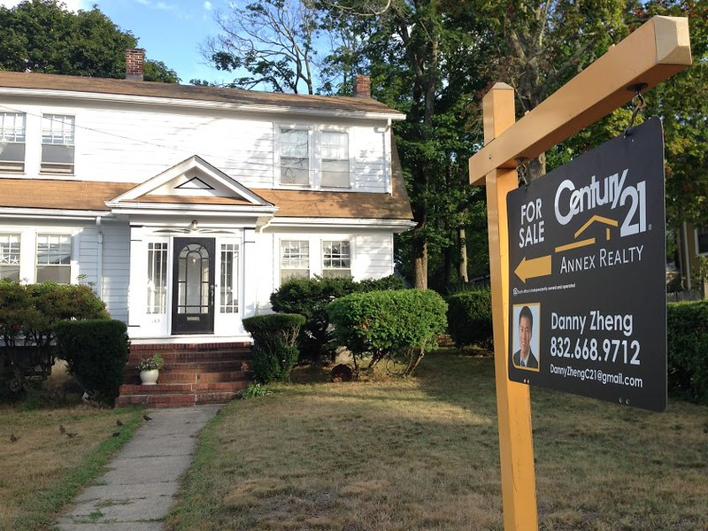
When Will You Sell Your Home?
Real Estate Machine Learning

Slide 2
Team Members
Caleb Sherry
Pat Petrus
Brian Smith
Max Eiteljorg

Slide 3
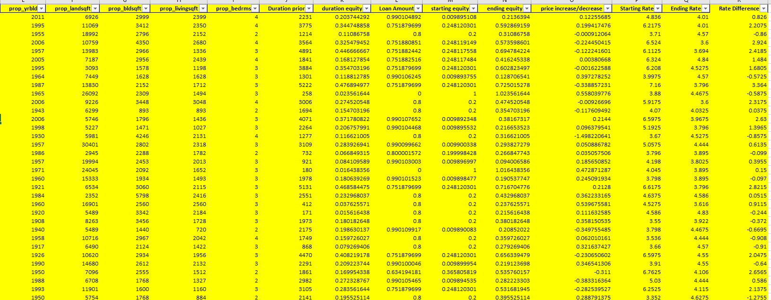
Data
Tax records pulled from the state of Indiana (publicly available)

Slide 4
Key Metrics
Zip Code
Year Built
Amount of Land
Building SQFT
Livable SQFT
Bedrooms
Duration Equity
Loan Amount
Starting Equity
Ending/Current Equity
Price Increase/Decrease
Starting Interest Rate
Ending/Current Interest Rate

Slide 5
Additional Information Wanted
Age of occupants
Children (ages)
Martial Status
Multiple Tax Record Years
What Happened Before and After
Renovations
More Complete Data on Financials

Slide 6
How Did We Do It?
Html/CSS/JavaScript
Tableau
Python
Pandas
Matplotlib
Machine Learning

Slide 7
What Next
Gather additional data
Phone numbers for sellers
Additional information wanted slide
Gather comparable data to send to the homeowner
Market to Realtors or Real Estate Investment Firms

Slide 8
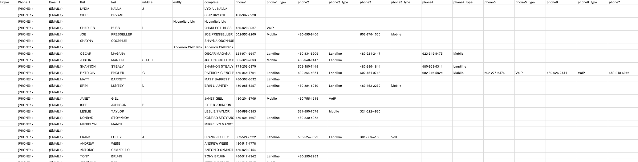
Examples of Monetization
Record #234555

Slide 9
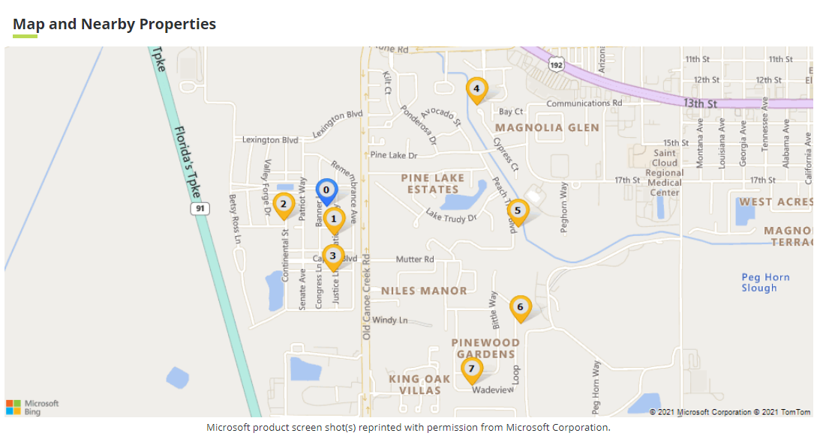
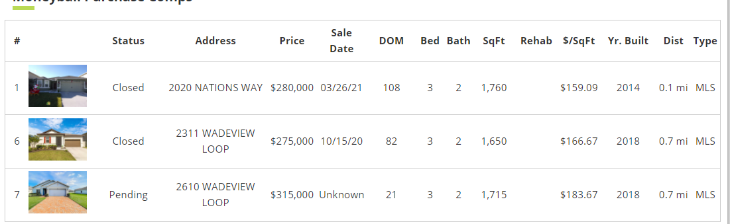

Marketing Package- Realtors
Now is the perfect time to sell and based on the comps in your area I think your home could sell from $315,000+ call me today to discuss your real estate needs!

Slide 10
Marketing Package- Institutional Buyers
-We want to buy your house with cash for $315,000 and close quick.
-You choose the closing date as soon as 21 days and as late as 6 months
-Hassle free transaction with the help of our experienced team
-Call today to learn more!

Slide 11
Will you sell next?
For more information visit https://github.com/patpetrus/real-estate-machine-learning

